Slide 1

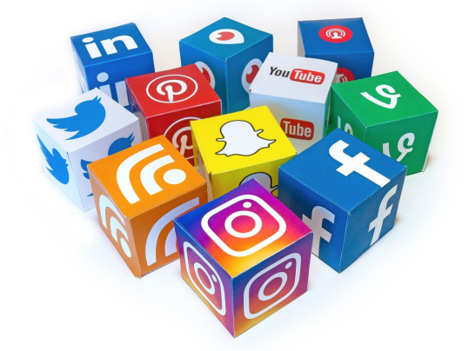
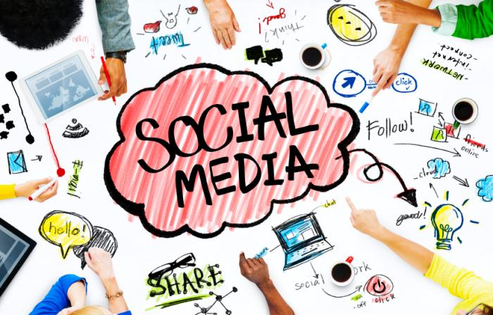

RAMAKRISHNA MISSION SHILPAMANDIRA COMPUTER CENTRE
PRESENTATION OF SOCICAL MEDIA
Presentation by RITESH TIWARI

Slide 2
Social media
Social media are computer-mediated technologies that facilitate the creation and sharing of information, ideas, career interests and other forms of expression via virtual communities and networks. The variety of stand-alone and built-in social media services currently available introduces challenges of definition; however, there are some common features
Social media are interactive Web 2.0 Internet-based applications.
User-generated content, such as text posts or comments, digital photos or videos, and data generated through all online interactions, are the lifeblood of social media.
Users create service-specific profiles for the website or app that are designed and maintained by the social media organization.
Social media facilitate the development of online social networks by connecting a user's profile with those of other individuals or groups.

Slide 3
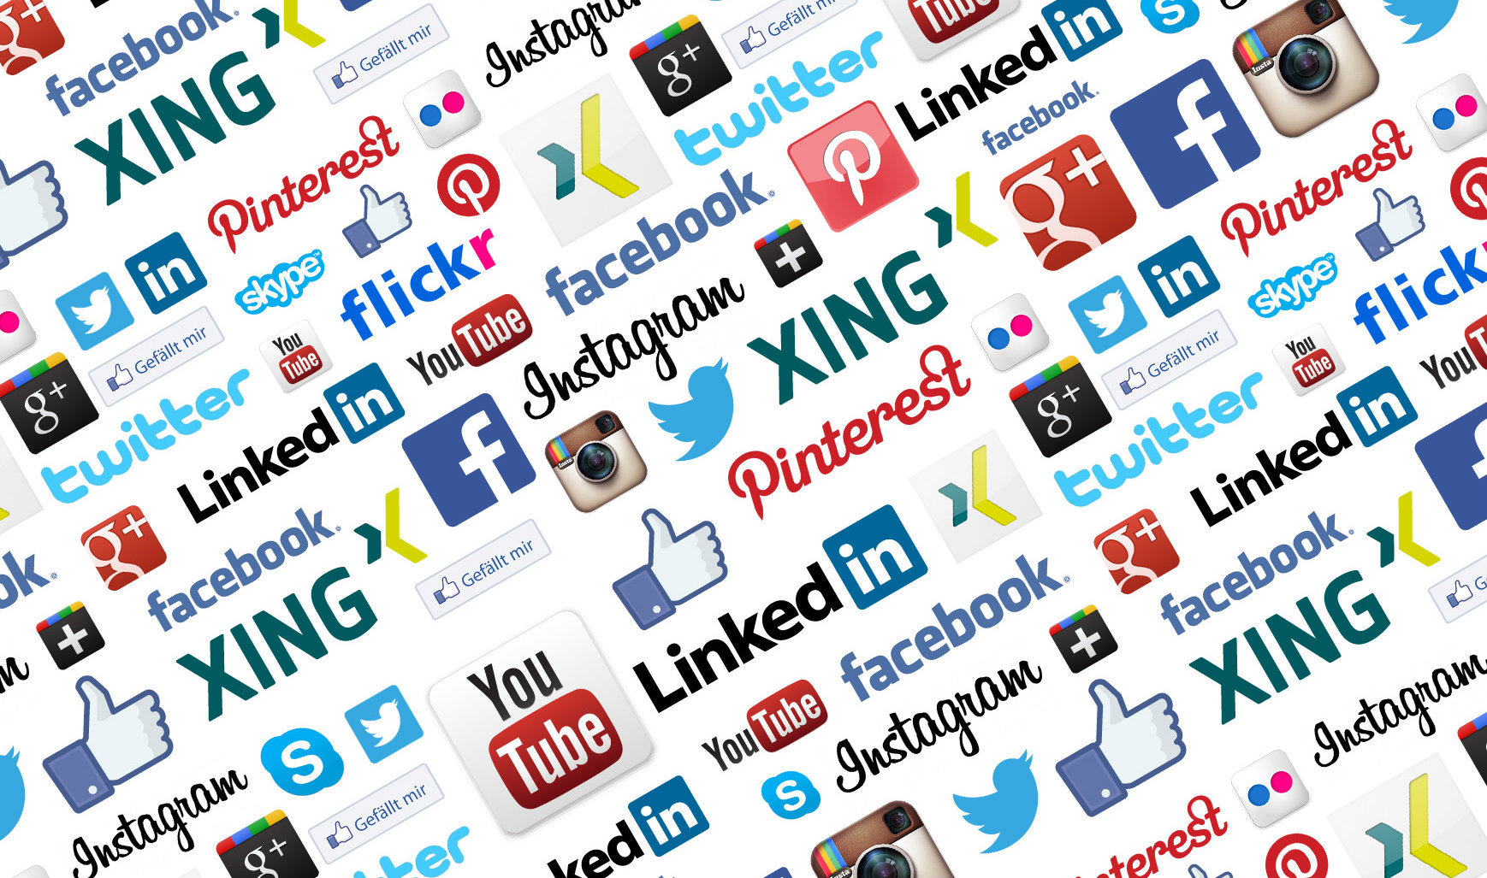
Users typically access social media services via web-based technologies on desktop computers, and laptops, or download services that offer social media functionality to their mobile devices (e.g., smartphones and tablet computers). Some of the most popular social media websites are Baidu Tieba, Facebook (and its associated Facebook Messenger), Gab, Google+, Instagram, LinkedIn, Pinterest, Reddit, Snapchat, Tumblr, Twitter, Viber, VK, WeChat, Weibo, WhatsApp, Wikia, and YouTube. These social media websites have more than 100,000,000 registered users.

Slide 4

Observers have noted a range of positive and negative impacts of social media use. Social media can help to improve individuals' sense of connectedness with real or online communities and social media can be an effective communication (or marketing) tool for corporations, entrepreneurs, nonprofit organizations, including advocacy groups and political parties and governments.

Slide 5


FACEBOOK
Facebook is an American for-profit corporation and an online social media and social networking service based in Menlo Park, California. The Facebook website was launched on February 4, 2004, by Mark Zuckerberg, along with fellow Harvard College students and roommates, Eduardo Saverin, Andrew McCollum, Dustin Moskovitz and Chris Hughes.
The founders had initially limited the website's membership to Harvard students; however, later they expanded it to higher education institutions in the Boston area, the Ivy League schools and Stanford University. Facebook gradually added support for students at various other universities, and eventually to high school students as well. Since 2006, anyone who claims to be at least 13 years old has been allowed to become a registered user of Facebook, though variations exist in the minimum age requirement, depending on applicable local laws. The Facebook name comes from the face book directories often given to United States university students

Slide 6
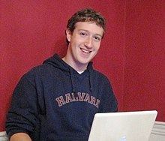
Facebook may be accessed by a large range of desktops, laptops, tablet computers, and smartphones over the Internet and mobile networks
Mark Zuckerberg, co-creator of Facebook, in his Harvard dorm room, 2005

Slide 7

WhatsApp
WhatsApp was officially made available for PCs through a web client, under the name WhatsApp Web, in late January 2015 through an announcement made by Koum on his Facebook page: "Our web client is simply an extension of your phone: the web browser mirrors conversations and messages from your mobile device—this means all of your messages still live on your phone". The WhatsApp user's handset must still be connected to the Internet for the browser application to function. All major desktop browsers are supported except for Microsoft Internet Explorer. WhatsApp Web's user interface is based on the default Android one.

Slide 8

BLOGGER
Blogger is a blog-publishing service that allows multi-user blogs with time-stamped entries. It was developed by Pyra Labs, which was bought by Google in 2003. Generally, the blogs are hosted by Google at a subdomain of blogspot.com. Blogs can also be hosted in the registered custom domain of the blogger (like www.example.com). A user can have up to 100 blogs per account
Blogger has launched mobile applications for users with mobile devices. Users can post and edit blogs, and also share photos and links on Blogger through their mobile devices. Not only advanced mobile devices, such as smartphones, are being considered, since users can also post blogs via traditional cell phones by SMS and MMS.

Slide 9

LIMKEDIN
LinkedIn is a business- and employment-oriented social networking service that operates via websites and mobile apps. Founded on December 28, 2002, and launched on May 5, 2003, it is mainly used for professional networking, including employers posting jobs and job seekers posting their CVs. As of 2015, most of the company's revenue came from selling access to information about its members to recruiters and sales professionals.

Slide 10
The site has an Alexa Internet ranking as the 20th most popular website (October 2016). According to the New York Times, US high school students are now creating LinkedIn profiles to include with their college applications. Based in the United States, the site is, as of 2013, available in 24 languages, including Arabic, Chinese, English, French, German, Italian, Portuguese, Spanish, Dutch, Swedish, Danish, Romanian, Russian, Turkish, Japanese, Czech, Polish, Korean, Indonesian, Malay, and Tagalog. LinkedIn filed for an initial public offering in January 2011 and traded its first shares on May 19, 2011, under the NYSE symbol "LNKD“.

Slide 11

INSTAGRAM
Instagram is a mobile, desktop, and Internet-based photo-sharing application and service that allows users to share pictures and videos either publicly or privately. It was created by Kevin Systrom and Mike Krieger, and launched in October 2010 as a free mobile app exclusively for the iOS operating system. A version for Android devices was released two years later, in April 2012, followed by a feature-limited website interface in November 2012, and apps for Windows 10 Mobile and Windows 10in April 2016 and October 2016 respectively.

Slide 12
The popularity of Instagram has sparked an engaging community, including dedicated "trends", in which users post specific types of photos on specific days of the week with a hashtag representing a common theme. Instagram has received positive reviews for its iOS app, and it has been named "one of the most influential social networks in the world". However, the company has been the subject of criticism, most notably for policy and interface changes, allegations of censorship, and illegal or improper content uploaded by users.

Slide 13
Instagram began development in San Francisco, when Kevin Systrom and Mike Krieger chose to focus their multi-featured HTML5 check-in project, Burbn, on mobile photography. As Krieger reasoned, Burbn became too similar to Foursquare, and both realized that it had gone too far. Burbn was then pivoted to become more focused on photo-sharing. The word Instagram is a portmanteau of instant camera and telegram

Slide 14
Presentation by Ritesh Tiwari
Thank you

